Slide 1
VELUX P2P Preparation
January 2022

Slide 2
CONTENT
Section | Page
Operating Model
Data Readiness
Buying Channel Strategy
As-Is Process review
Implementation Roadmap & Team

Slide 3








The SAP Source to Pay (S2P) Ecosystem
SUPPLIERS | SELL TO SETTLE
SAP CLOUD
PLATFORM
Ariba Network
CUSTOMER VALUE
SERVICES
SUPPLIER MANAGEMENT
STRATEGIC SOURCING
SUPPLY CHAIN
PROCUREMENT
FINANCIAL SUPPLY CHAIN
BUYERS | SOURCE TO SETTLE
SAP Ariba Supplier Lifecycle & Performance
SAP Ariba Sourcing
SAP Ariba Supply Chain Collaboration
SAP Ariba Buying
SAP Ariba Payables
Indirect access to SAP ERP
Supplier Enablement
SAP Ariba Supplier Risk
SAP Ariba Contracts
SAP Digital Supplier Network
Catalog Enablement
End User/ Supplier Support
SAP Ariba Spend Analysis
Sourcing Support Desk
eAuction Support
Note: SAP Ariba Procurement Analytics included in all solutions

Slide 4
Key preparation components
1
1
Ensure that the future state S2P process is integrated into the end to end operating model across Procurement, Finance and IT and make appropriate organisation, process, policy people and technology changes required to drive adoption
End to End Operating Model
End to End Operating Model
6
2
2
Buying Channels, Data, Content & Supplier Enablement
Buying Channels, Data, Content & SE
Determining the right buying channel for each category and supplier, develop content and supplier enablement strategy and execution in line with deployment plan.
Transformation and Program Planning
7
3
Finalize end to end global business process scope and capture business requirements in line with S2P functional best practice. Deep dive workshops on the integration between the different cloud applications and customer ERP
Setting the Project up for Success
End to End Process & SE
5
3
4
Define and evaluate the different deployment options in order to build out deployment strategy, sequence and plan
Change Learning, Adoption & Communication
End to End Process and Solution Architecture
Implementation Roadmap
4
Establish the scope of the Change Management efforts that will be executed during both the planning phase as well as implementation phases and define the sponsor group and change network. Execute initial program communications and define high level training and adoption strategy
5
Change, Learning, Adoption & Comms
Implementation Roadmap
6
Mobilize the entire program including each workstream with the objective to structure, plan, define and provide on-going implementation of both the required business change and solution implementation. Validate scope if required
Transformation & Program Plan

Slide 5
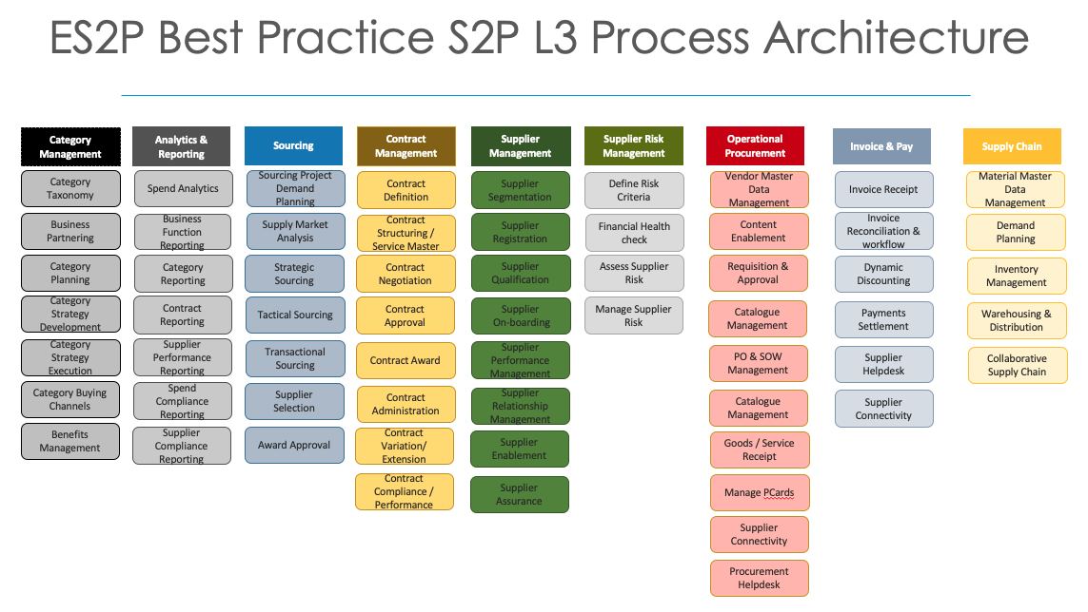
Procurement Strategy
1
Does your existing end-to-end Procurement Operating Model need to be changed in order to maximize the technology investment?
Have all the processes that your indirect procurement organization need been designed and ready from day 1? (e.g.: Self Service vs Central Buying?)
  If these don’t exist, then we will design these in the preparation phase
  If these do exist, then we can review during preparation and system enable
End to End Operating Model
3
End to End Process and Solution Architecture

Slide 6
What is a buying channel?
2
Buying Channels, Data, Content & Supplier Enablement
Sourcing
Create Request
Approve Request
Create PO
Transmit Order
Order Acknowledgement
Receive
Invoice Trans-mission
Approve Invoice
Strategic
Contract Only
Tactical Buy
Punch-out Catalogue
Cost Object
P-card
Spot Buy
Supplier-Managed Catalogue
Functional Approval
Auto PO
PO cXML
EDI/cXML
Requestor Receiving
EDI/XML
3 Way Match
Offline / Business
Partial Catalogue
No Approval
Demand Aggregation
PO E-Mail
Ariba Network
Central Receiving
Ariba Network
2 Way Match
Internally-Managed Catalogue
PO Ariba Network
Manual Email
Automatic Receiving
Email PO Flip
2.5 Way Match
Complete PR Form
PO Manual
No Acknowledgement
No Receiving
Email PDF
Invoice Only
Collaborative
(3 bids)
Manual/Image
Service PR
Each of the key steps within the S2P process will have multiple options.
Selecting and utilizing the most effective option will be based on the type of purchase, the level of contract compliance, control, spend visibility and efficiency required.
Free Text Requisition

Slide 7
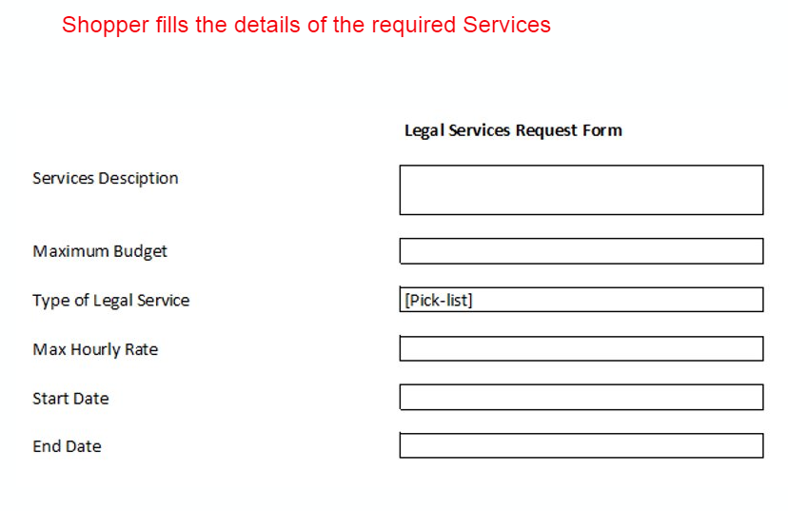
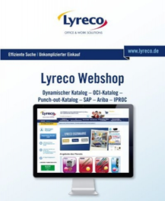
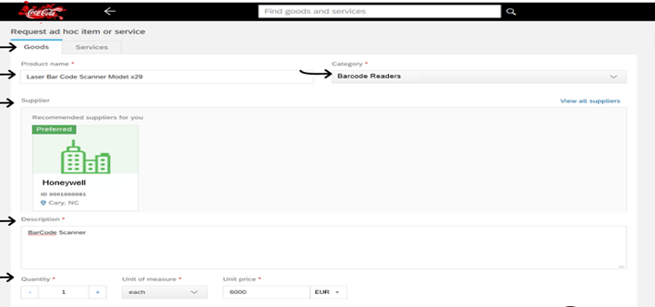
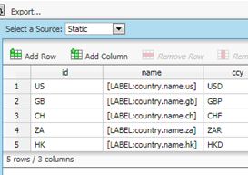
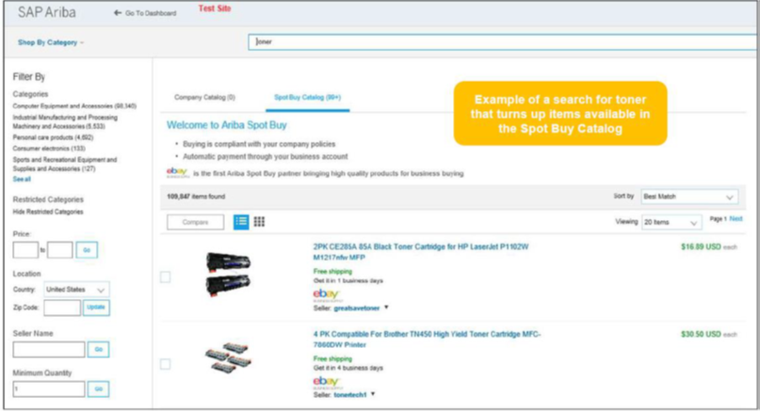

The concept of High and Low Touch Buying Channels
2
Buying Channels, Data, Content & Supplier Enablement
HIGH TOUCH: Less frequent requests requiring supporting information
Less Efficiency More Control
Effective Buying Channel Strategies drive more expenditure through lower touch categories & use policies to maintain control
LOW TOUCH: Recurrent request with defined Specifications
More Efficiency Less Control
Highest Touch
Lower Touch
Lowest Touch
PUNCH OUT CATALOUES
SERVICE / FREE TEXT POs
REQUEST FORMS
STATIC CATALOGUES
SPOT BUY
LOW TOUCH
RFQ
SELF-
SERVE
RFQ
HIGH TOUCH RFQ / SOURCING REQUEST

Slide 8
Spend Analytics Analysis
2
Buying Channels, Data, Content & Supplier Enablement
Analysing spend will identify which suppliers to target for content enablement and what spend could be tactically sourced
Procurement Managed
Already Contracted
Content Enablement
Priority 2
Priority 1
Spend = £X (X%) Suppliers = X Transactions = X%
Spend = £X (X%)
Suppliers = X
Transactions = X%
Spend = £X (X%)
Suppliers = X
Transactions = X%
Tactical Sourcing
Key Inputs:
Spend data by supplier
PO & invoice transactional data
2nd Tier
Strategic Importance
(Annual Value of PO’s)
Spend = £X
Suppliers = X
Transactions = X%
Priority 3
Spend = £X (X%)
Suppliers = X
Transactions = X%
Transactional
Low Value – Low Automation Potential
Non-Critical
Spend = £X (X%) Suppliers = X Transactions = X%
Non-Critical
Low
Medium
High
Under 50
>= 50
>= 100
>= 250
Automation Potential
( Number of Transactions Per Year)

Slide 9
Velux Taxonomy
2
Buying Channels, Data, Content & Supplier Enablement
The recommendation for Ariba Guided Buying is to have 9-12 level one categories.
Velux currently has 10 indirect categories with a further 8 direct categories.
Level One | Content Options
FACILITIES MANAGEMENT | Punchout Supplier Managed Catalogue Partial Catalogue
HUMAN RESOURCES | Partial Catalogue
IT / TELECOM | Punchout Partial Catalogue
LOGISTICS | Partial Catalogue
MARKETING | Partial Catalogue
PROFESSIONAL SERVICES | Partial Catalogue
OPEX | Supplier Managed Catalogue
CAPEX
MATERIAL HANDLING EQUIPMENT | Supplier Managed Catalogue
TRAVEL | Partial Catalogue Forms

Slide 10







P2P Solution Summary
Supplier
Purchase Order material / service
Non-PO Invoice
Trading relationship
Order confirmation
Ship Notice
Service entry sheet
Goods receipt
Invoice
Remittance
Business rules
Buyer
Purchase requisition
Update PO line items
Service entry sheet
SES status update
Ariba Buying
Purchase order
Goods receipt
Cloud Integration Gateway
Cloud connector
SAP ECC or S4/HANA
OpenText VIM
Invoice
Invoice Status Update
MM
Purchase Order
Purchase Change/ Cancel
Goods receipt
Invoice
FI
Payment remittance

Slide 11


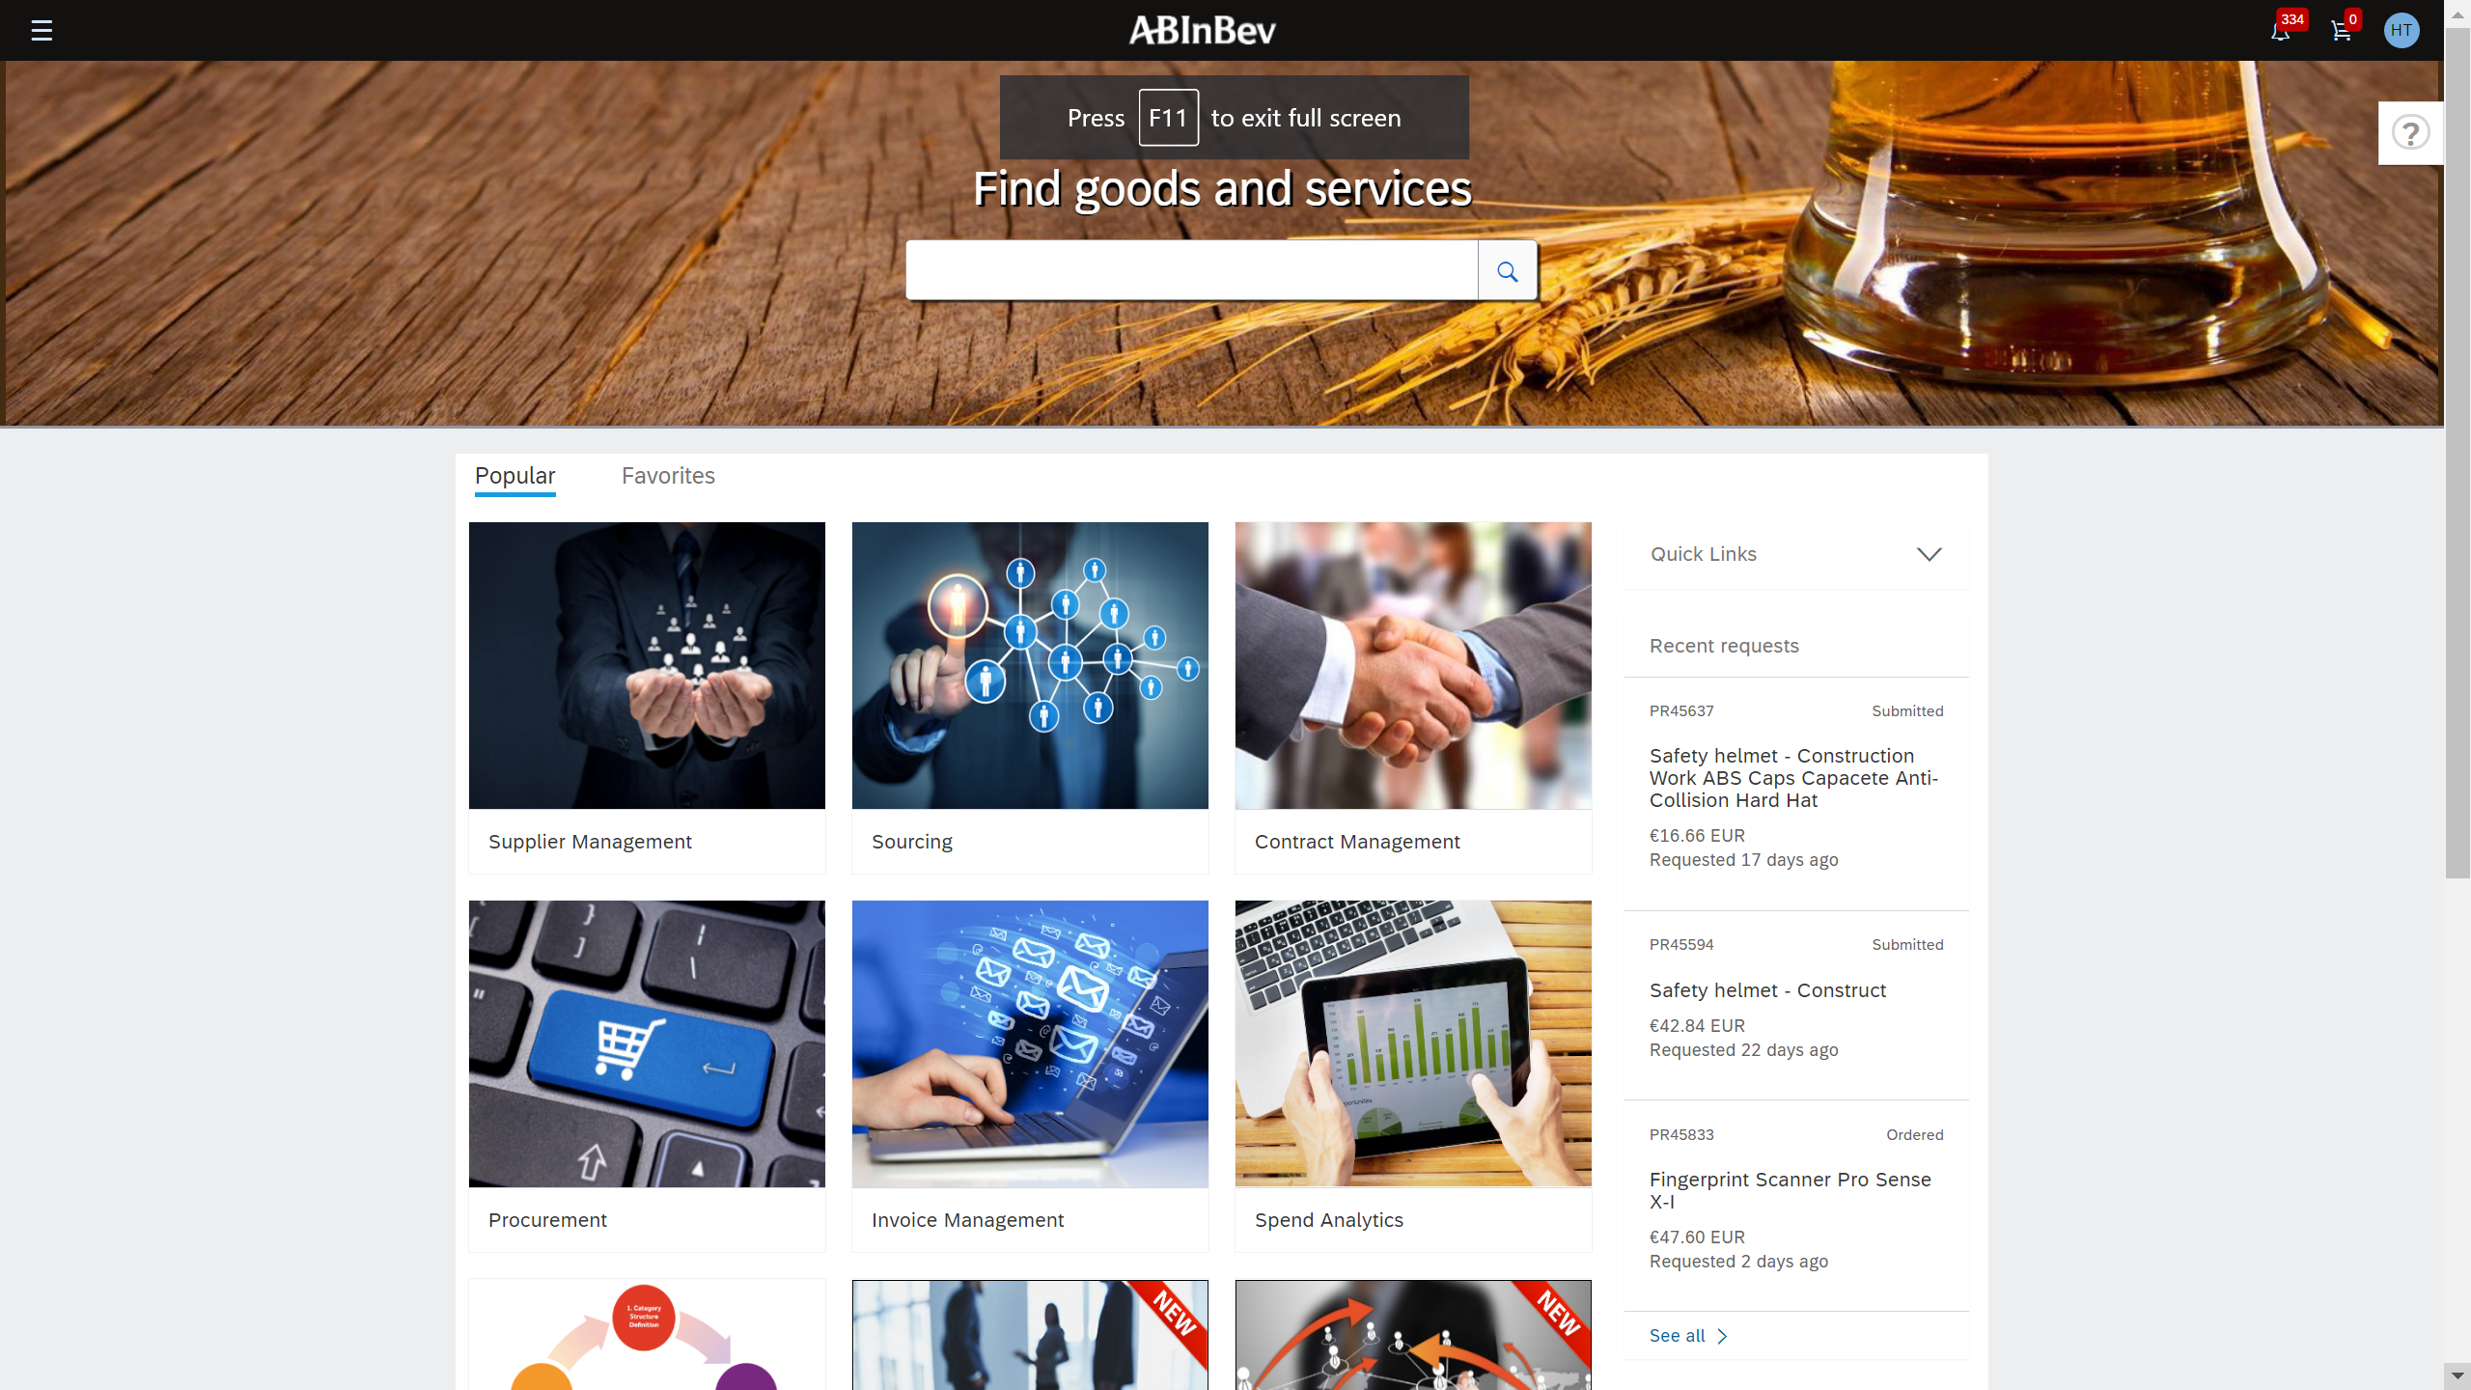
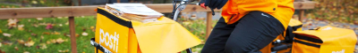
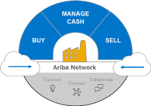









SAP Ariba Content Enablement Options
2
Buying Channels, Data, Content & Supplier Enablement
4
Sourcing Opportunities
1
SpotBuy
(external marketplaces, Amazon, eBay etc)
Sourcing
Sourcing Award
Contract
Terms
Supplier Catalog
Self-Service
Supplier
Catalog
Processing
Guided Buying
Guided Buying
Import / Integration
- Catalog review
- Difference reports
- Buyer rules
- Approvals
2
- Validation
- Cleansing
- Enrichment
3
ERP Item Masters
Wsajksjdf
Sfsdfwerwerwer
Werwer
Werwererer
Werwererwerwer
Werwerwerwwre
Werwewewrer
Werwrerwerwerrwe
PO Inventory PO
Item masters (storage locations, stock levels, BPN)
5
Buyer
Managed

Slide 12
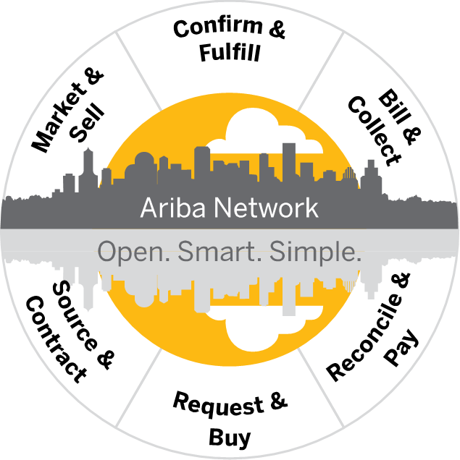



Ariba Network – Supplier Enablement
Multiple Options for Suppliers
2
Buying Channels, Data, Content & Supplier Enablement
Portal
Suppliers
POs via
Email, Fax, Online
cXML
POs
Seller
Ariba Buying
&
Invoicing
Confirmations, Ship Notices
Invoices
Invoice Status
Seller
POs
ERP
Confirmations, Ship Notices
Invoices
cXML
Invoice Status
Seller ERP
Remittances
EDI
Integrated Suppliers
Seller ERP
CSV
Seller ERP
Notes:
To help us prepare for enabling all types of suppliers, we need to understand the scope so we can build the appropriate materials needed to communicate the requirements and process changes to suppliers

Slide 13
3
End to End Process and Solution Architecture
process Architecture
Level 3

Slide 14
P2P Implementation Levels
4
Implementation Roadmap
Basic
Developed
Advanced
Sophisticated
Optimised
Guided Buying UI
Requisitions and Purchase Orders
Forms, Partial Forms & Catalogues
Contract Compliance
Standard Receiving
Simple approvals
Guided Buying interface built around the required spend categories.
Simple approvals based on cost centre, hierarchy and value.
PO and GRN integration
Spot Buying
Tactical Sourcing
Service Orders & Service Entry Sheets
Spot Buy is added to manage tail spend.
Tactical Sourcing implemented to drive higher value, ad-hoc spend through preferred suppliers and procurement policies.
Complex services enabled through service orders and service entry sheets.
Budget Real-time checking
Advanced Payments
Evaluated Receipt Settlement
Advanced approvals
Purchases validated against contracts and budgets.
Advance Payments and ERS supported.
Approval processes expanded to include all required accounting data.
Collaborative Requisitioning and Demand Aggregation
Queue Management
Asset Receiving
Total Landed Cost
Procurement Policies
Purchases validated against procurement policy in real-time.
Purchasing streamlined and consolidated through collaborative requisitioning, demand aggregation and queue management.
Asset Receiving may be enabled to support asset management in back-end ERP.
Integration with other systems, e.g., Fieldglass, ServiceNow and Concur
Procurement Operations Desk
Purchasing processes extended to integrate with other spend management tools such as ServiceNow.
Centralised Procurement Operations / SSC functionality to manage low value, tactical sourcing and tail spend
Extended use of Fieldglass and ARIBA to manage external workforce

Slide 15
AN & Invoicing Implementation Levels
4
Implementation Roadmap
Basic
Developed
Advanced
Sophisticated
Optimised
Indirect goods, materials & simple services
Ariba Buying initiation
PO & GR replication
Invoice Remittance
Purchase Orders and Goods Receipts created in Ariba Buying are replicated to back-end ERP for invoice matching and financial reconciliation.
Invoice remittance status information updated from ERP based on payment status.
Invoice Status
IIE for paper & PDF invoice capture
Invoice status information driven by AP process exception handling.
Paper invoices and flat PDF’s processed either in-house or by a service provider, received via Ariba Network.
Service Entry Sheets MRO & Direct Spend
Order Confirmations
Advanced Shipping Notifications
Service Entry Sheets are created in Ariba Buying and pushed to ECC as the services receipt.
Purchase Orders and Goods Receipts created in ERP submitted to suppliers over the Ariba Network.
Order Confirmations and ASNs are received directly into ERP to update MRP Production Schedules.
Fiori apps for requisitioning & receiving MRO spend
Ariba Catalogues
Fiori apps deployed for MRO purchasing.
Ariba Catalogues available to MM & Plant Maintenance in ERP
Supply Chain Collaboration
Work Order Management
Demand forecasts shared with suppliers over the network with changes and confirmations
Inventory levels managed over the network with changes and confirmations
Work Orders shared with suppliers over the network with confirmations and changes

Slide 16

4
excelerateds2p implementation Roadmap
Implementation Roadmap
Phase | Month 1 | Month 2 | Month 3 | Month 4 | Month 5 | Month 6 | Month 7 | Month 8
Phase
Setting the Project up for Success
Full Solution and Integration Build
Deploy Solution by Region
SAP Ariba Buying
Full Deployment
Procure to Pay Solutions
Training & Hypercare
Buying Channels Enabled
Guided Buying and Content Enablement
Approval Flows
Commerce Automation Business Transaction rules
All Buying Channels Enabled
Additional Guided Buying and Content Enablement Build
Additional Approval Flows
Project Mobilisation
Project Governance Framework
Solution & Integration Design
Selected Regions
Selected User Base
Selected Categories
Integration
CIG / Cloud Connector set up
Single Sign On
FINVOICE to IIE
P2P integration to SAP ECC
Catalogue Syndication Inventory Feed
Example only
Change Management
Implementation
Master Load Loads
Programme Management
Confidential - Not to be shared without permission
Notes:
The approach we propose is to conduct an initial “Setting the Project up for Success” preparation phase, during which all system design work will be completed,
22+2 weeks
Already have SCC + CA
Big Bang
Guided Buying? Operating model
1 x Functional Lead
1 x Enablement
1 x Technical – 2-3day/wk (Martin)
1 x Change - Carl

Slide 17
Change Management
Leveraging SDP S2C Change Understanding and Assets
5
Change, Learning, Adoption & Communication
Lessons Learned
Positive feedback on blended approach
Assets
Brand pack and style
Comms templates
Methodology
P2P Differences
Broader stakeholder group
Broader and more varied audience group
Target Operating Model changes require more planning, roll out and adoption support
Three stage change methodology works – awareness, embedding, adoption
Templated activities covering all three stages
in person sessions,
Established and repeatable stakeholder management strategy and materials
Learning journey template in cornerstone
Stakeholder briefing templates
Supplier briefing templates
Evaluation templates
Roles and responsibilities within change established (lead, project manager, practitioner, SME)
End user engagement more limited (part of thier role as opposed to all/most of their role) requires different focus
Local language needs makes the change network critical
How to get ‘the right level’ of comms and engagement – not too much, not to little, in line with known Velux culture
online support in teams,
super users,
Learning journeys
quick guides,
adoption support
Over 200 people trained, over 60 templates assets created ,
Over 400 man hours of change management experience of working with excelerateds2p change methodology

Slide 18
High Level Team Structure - Delivery
6
Transformation and Program Planning
Programme Board
Programme Management
PMO
Key
Exec Sponsors
Programme QA
IT Sponsor/Lead
SAP Sponsor
SI Partner
Programme Manager
PMO Support
Velux
SAP
Project
Ariba Project Manager
TBC
Workstream
Change & Adoption Project Manager
TBC
Testing Manager
Data Migration Manager
Ariba Procure to Pay
Technical & Integration
Change Management Workstream
Enablement
Testing Workstream
Data
P2P Lead Consultant
SAP MM Consultant
Technical Lead
IIE Technical Consultant
Change Sponsor Procure 2 Pay (SME)
Supplier Enablement Lead
Procurement & Supply Chain Test Lead
Data Migration Lead
Ariba Procurement Content Enablement
P2P Process Lead
Commerce Automation Consultant
SAP Basis Consultant
Change Practitioner
Supplier Enablement Services
Test Analysts*
Data Migration Analysts*
Payables Process Lead
P2P Process Analysts
SAP ABAP Consultant
Roles & Authorizations Consultant
P/T Comms manager
Enablement Coordinators*
Data Migration Consultant
Ariba Service Consultant
Ariba Technical Support

Slide 19
Project Governance
6
Transformation and Program Planning
Strategic Focus
Executive Steering Meeting
(Monthly)
Executive Partnership
Oversight and Authority
Monitoring progress to the plan
Strategic Planning
Resolution of escalated project issues
VELUX
Senior Leadership
Program Sponsors
Stakeholder Committee
SI Partner
Senior Leadership
Engagement Partner
SAP Account Manager
Monitor and Control
Management Team / PMO
(Weekly)
Monitoring program delivery and project progress
Implementing strategic plans
Making decision resolving risks and issues
Report to Executive Steering Committee
VELUX
Program Manager
Functional Owners
Project Managers
SI Partner
Engagement Partner
Project Managers
Operational Performance Focus
Project Management
(Daily)
Tracking project plan
Identifying potential risks and issues
Resolving potential risks and issues
Report to Management Team / PMO
VELUX
Project Managers
Process Leads
SI Partner
Project Managers
Team Leads

Slide 20
Setting up the project for success
7
Setting the Project up for Success
1
2
1
Buying Channels
Master Data Readiness
Buying Channels
Complete Buying Channels mapping exercise to define Velux ways to buy & pay across all Indrect categories
2
Cleansed master data is foundational to a successful P2P implementation. During the early phases of the project, an effort needs to be undertaken to assess all P2P master data objects such as vendors, approvals, content, contracts, policies and cleanse where required.
Master Data Readiness
5
3
3
Organisation Readiness
Ensuring that the to-be organisation and personas are clearly understood, and to formalise and build a change, adoption and learning strategy.
Change Readiness
Organisation Readiness
4
Clients typically need to make a design decision around the migration of existing content and ensuring there is a process in place to manage and maintain this content along with new content
4
Content Management
Content Management
5
Change Readiness
Ensuring that the Change Management strategy is defined and ready to execute, with all stakeholders engaged and ready.

Slide 21
Scenarios
The following example cases were created specifically for another excelerateds2p client and are included in this pack as an example of what we could create if you can provide some VELUX specific scenarios.

Slide 22
Case 1
Preferred service vendor identified below MDKK 1 – Low risk

Slide 23












Preferred service vendor identified below MDKK 1 – Low risk
A Requestor has through Guided Buying identified Deloitte as a preferred vendor he/she would like to engage with. Deloitte will be preparing and facilitating a 3-day workshop.
CASE 1
YES
They can select the appropriate item(s) and see they are linked to the MSA contract
The user submits purchase requisition for approval, procurement approval not required for catalog purchases
After add the items to their cart they proceed to checkout and provide estimated quantities (e.g. number of days)
They navigate to the service landing page…
Once fully approved, the PO is automatically sent to the supplier
Is the service covered by catalog items? E.g. day rates
User has a need to buy from a Preferred Vendor and enters Guided Buying from intranet
…or they search for the supplier and views the supplier profile
No
They complete a line item form
They complete service details and risk assessment questions in the form …
…and select their supplier from the Preferred list
User proceeds to checkout and sees that the MSA contract reference has been automatically populated
User submits purchase requisition for approval, procurement approval required to ensure pricing adheres to MSA

Slide 24
Preferred service vendor identified below MDKK 1 – Low risk
CASE 1
YES
They can select the appropriate item(s) and see they are linked to the MSA contract
The user submits purchase requisition for approval, procurement approval not required for catalog purchases
After add the items to their cart they proceed to checkout and provide estimated quantities (e.g. number of days)
They navigate to the service landing page…
How does the Requestor understand which services are covered by the MSA?
How does the Requestor provide a concrete service description to Deloitte?
Catalog items should be under contract or the supplier is marked as preferred for that service (best practice)
The form fields will help to provide detail services required
Once fully approved, the PO is automatically sent to the supplier
Is the service covered by catalog items? E.g. day rates
User has a need to buy from a Preferred Vendor and enters Guided Buying from intranet
…or they search for the supplier and views the supplier profile
No
They complete a line item form
They complete service details and risk assessment questions in the form …
…and select their supplier from the Preferred list
User proceeds to checkout and sees that the MSA contract reference has been automatically populated
User submits purchase requisition for approval, procurement approval required to ensure pricing adheres to MSA

Slide 25
Preferred service vendor identified below MDKK 1 – Low risk
CASE 1
YES
They can select the appropriate item(s) and see they are linked to the MSA contract
The user submits purchase requisition for approval, procurement approval not required for catalog purchases
After add the items to their cart they proceed to checkout and provide estimated quantities (e.g. number of days)
They navigate to the service landing page…
How does the Requestor ensure the engagement is governed by the MSA?
How does the requestor ensure that the cost of the service matches the commercial terms of the MSA?
The MSA can be automatically linked for catalog items and non-catalog items using Contract Compliance
Catalog items can be set up to match the contract and for non-catalog items, procurement can be automatically added as an approver to check the commercial terms
Once fully approved, the PO is automatically sent to the supplier
Is the service covered by catalog items? E.g. day rates
User has a need to buy from a Preferred Vendor and enters Guided Buying from intranet
…or they search for the supplier and views the supplier profile
No
They complete a line item form
They complete service details and risk assessment questions in the form …
…and select their supplier from the Preferred list
User proceeds to checkout and sees that the MSA contract reference has been automatically populated
User submits purchase requisition for approval, procurement approval required to ensure pricing adheres to MSA

Slide 26
Case 2
Preferred vendor identified – purchase requires new GDPR Annex A

Slide 27




Preferred vendor identified – purchase requires new GDPR Annex A
The Requestor has identified a Preferred Market Research agency for a consultancy service. The service requires an individual DPA just as the information shared with the vendor is especially confidential.
CASE 2
They complete service details and risk assessment questions …
User sees Warning that DPA required & guidance of how to request DPA
User selects DPA justification and submits form
They navigate to the service landing page…
YES
They choose the Line Item form
…and select their supplier from the Preferred list
User follows guidance link and submits contract request for DPA
User checks out shopping cart and submits for approval. Procurement are an approver to ensure DPA is in place
Do they have a quote?
User has a need to buy from a Preferred Vendor and enters Guided Buying from intranet
…or they search for the supplier and views the supplier profile
No
They choose the Request form
They complete service details and risk assessment questions …
…and select their supplier from the Preferred list
User sees Warning that DPA required & guidance of how to request DPA
RFQ process is followed to request quote, and is awarded to supplier

Slide 28
Preferred vendor identified – purchase requires new GDPR Annex A
CASE 2
They complete service details and risk assessment questions …
User sees Warning that DPA required & guidance of who to contact to put in place a DPA
User selects DPA justification and submits form
They navigate to the service landing page…
YES
They choose the Line Item form
…and select their supplier from the Preferred list
How does the Requestor know that the service should be risk assessed?
How does the Requestor conduct the risk assessment?
Risk assessment questions automatically appear in request and line item forms
They answer the Risk Assessment questions – Best practice is mix of quantitative questions to calculate risk rating
User follows guidance link and submits contract request for DPA
User checks out shopping cart and submits for approval. Procurement are an approver to ensure DPA is in place
Do they have a quote?
User has a need to buy from a Preferred Vendor and enters Guided Buying from intranet
Risk rating can determine user journey e.g. High, Medium Low
…or they search for the supplier and views the supplier profile
No
They choose the Request form
They complete service details and risk assessment questions …
…and select their supplier from the Preferred list
User sees Warning that DPA required & guidance of who to contact to put in place a DPA
RFQ process is followed to request quote, and is awarded to supplier

Slide 29
Preferred vendor identified – purchase requires new GDPR Annex A
CASE 2
They complete service details and risk assessment questions …
User sees Warning that DPA required & guidance of how to request DPA
User selects DPA justification and submits form
They navigate to the service landing page…
YES
They choose the Line Item form
…and select their supplier from the Preferred list
How does the Requestor involve Procurement in the DPA creation?
The guidance links the user to create a contract request for the DPA which procurement can then action
User follows guidance link and submits contract request for DPA
User checks out shopping cart and submits for approval. Procurement are an approver to ensure DPA is in place
Do they have a quote?
User has a need to buy from a Preferred Vendor and enters Guided Buying from intranet
They then have an approval on the Purchase Requisition to ensure the DPA has been actioned before the PO is sent to the supplier
…or they search for the supplier and views the supplier profile
No
They choose the Request form
They complete service details and risk assessment questions …
…and select their supplier from the Preferred list
User sees Warning that DPA required & guidance of how to request DPA
RFQ process is followed to request quote, and is awarded to supplier

Slide 30
Case 3
No preferred vendor available – need to engage ad hoc low risk vendor

Slide 31


No preferred vendor available – need to engage ad hoc low risk vendor The Requestor is searching for entertainment for his department event and does not find a preferred or qualified vendor within this space. The estimated cost is DKK 100,000 and he has (based on a Google search and conversation with the vendor) identified Social events as the right vendor
CASE 3
YES
They find the supplier in the system
They add the supplier and as the service is low risk…
User provides justification, submits form and and proceeds with Checkout
They have found a supplier via Google and spoken to them to get a quote…
They search the system for their service and find a line item form…
…they see a Warning that they are preceding with a non-preferred supplier
They return to the form and as the service is low risk see a warning message with a link to request a new supplier..
User has a need to buy something and enters Guided Buying from intranet
But there are no suitable preferred suppliers
…and search for that supplier in the form
No
They cannot find the supplier in the system
…and follow the link to raise a new supplier request
They have to wait for the request to be processed and the supplier to be registered and qualified before they can proceed

Slide 32
No preferred vendor available – need to engage ad hoc low risk vendor
CASE 3
YES
They find the supplier in the system
They add the supplier and complete the service and risk elements of the form
User provides justification, submits form and and proceeds with Checkout
How does the Requestor ensure a proper service description?
They have found a supplier via Google and spoken to them to get a quote…
Form fields would capture the details of service, guidance information can also be provided
They search the system for their service and find a line item form…
…but see a Warning that they are preceding with a non-preferred supplier
How does the Requestor know that the service should be risk assessed?
They return to the form and see a link to request a new supplier..
User has a need to buy something and enters Guided Buying from intranet
But there are no suitable preferred suppliers
…and search for that supplier in the form
Risk assessment questions automatically appear in request and line item forms
No
They cannot find the supplier in the system
…and follow the link to raise a new supplier request
They have to wait for the request to be processed and the supplier to be registered and qualified before they can proceed

Slide 33
No preferred vendor available – need to engage ad hoc low risk vendor
CASE 3
YES
They find the supplier in the system
They add the supplier and as the service is low risk…
User provides justification, submits form and and proceeds with Checkout
How does the Requestor know that he should use a PO as contract basis?
No contract will match when checking out meaning the order will be placed purely on PO terms
They have found a supplier via Google and spoken to them to get a quote…
They search the system for their service and find a line item form…
…they see a Warning that they are preceding with a non-preferred supplier
How does the Requestor Know that it is okay to accept Socialevent’s T&Cs if the vendor insists on these?
They return to the form and see a link to request a new supplier..
User has a need to buy something and enters Guided Buying from intranet
But there are no suitable preferred suppliers
…and search for that supplier in the form
Guidance on when using Supplier’s terms and conditions is acceptable can be added to the form – possibly as part of the risk assessment
No
They cannot find the supplier in the system
…and follow the link to raise a new supplier request
They have to wait for the request to be processed and the supplier to be registered and qualified before they can proceed

Slide 34
No preferred vendor available – need to engage ad hoc low risk vendor
CASE 3
YES
They find the supplier in the system
They add the supplier and complete the service and risk elements of the form
User provides justification, submits form and and proceeds with Checkout
How does the requestor know that Socialevents should be registered as a vendor in SAP prior to PR creation?
They have found a supplier via Google and spoken to them to get a quote…
They search the system for their service and find a line item form…
…but see a Warning that they are preceding with a non-preferred supplier
The warning message can contain this guidance, supplier can be a required field in order to submit a shopping cart
They return to the form and as the service is low risk see a warning message with a link to request a new supplier..
User has a need to buy something and enters Guided Buying from intranet
But there are no suitable preferred suppliers
…and search for that supplier in the form
No
They cannot find the supplier in the system
…and follow the link to raise a new supplier request
They have to wait for the request to be processed and the supplier to be registered and qualified before they can proceed

Slide 35
Case 4
No preferred vendor available – need to engage ad hoc risk vendor

Slide 36


No preferred vendor available – need to engage ad hoc risk vendor
The Requestor is searching for an R&D consultancy firm to get advice on a compound. The estimated cost is DKK 900.000 and confidentiality as well as IP rights are at risk.
CASE 4
The service is deemed to be high risk
They search the system for their service and find a line item form…
Once contract is in place the user can go back and recomplete the form fields
User has a need to buy something and enters Guided Buying from intranet
They and complete the service and risk elements of the form and there are no preferred suppliers although there is a registered supplier
Legal support in agreeing a contract to cover confidentiality and IP risks
As legal have been engaged the risk is deemed medium and the user can proceed to Checkout with justification
…so an error message appears advising the user to raise a contract request to engage legal

Slide 37
No preferred vendor available – need to engage ad hoc risk vendor
CASE 4
How does the Requestor know that the purchase is considered or should be evaluated high risk?
The service is deemed to be high risk with no preferred vendor
They search the system for their service and find a line item form…
Once contract is in place the user can go back and recomplete the form fields
Risk assessment questions will determine the service is high risk and error message will be displayed
How does the Requestor proceed to Legal support?
User has a need to buy something and enters Guided Buying from intranet
They and complete the service and risk elements of the form and there are no preferred suppliers although there is a registered supplier
Legal support in agreeing a contract to cover confidentiality and IP risks
As legal have been engaged the risk is deemed medium and the user can proceed to Checkout with justification
…so an error message appears advising the user to raise a contract request to engage legal
There is a link in the error message to submit a contract request for legal support

Slide 38
Case 5
Preferred Vendor available, additional risk assessment needed (Research)

Slide 39
Preferred Vendor available, additional risk assessment needed (Research)
The Requestor knows already the Preferred Vendor and that it is applicable for the service needed – a new animal study to be conducted by the vendor. The estimated cost is DKK 900.000 and confidentiality as well as IP rights are at risk.
How does the Requestor ensure that the animal species has been approved by veterinarians (a key GxP requirement for all animal studies)?
This will depend on how this information is stored but 2 options are:
the form could ask them to specify the animal species and have hidden logic to check if approved
there could be an approved list that they are prompted to check and confirm if their species is on it
If the animal species has not been approved, how does the Requestor get Procurement Support to ensure this is done at the right timepoint as a part of the dialogue with the vendor?
The form can display an error to prevent them preceeding and point them to contact Procurement for support – possibly via a Custom Form for new animal species approval
Ensure to get a proposal from the vendor that is easily transferrable into a Work Order/SOW/PO (standard content of a WO, but specifics around the animal species may be needed)?
If using a tactical sourcing, the RFQ details will transfer into a Work Order, including specification provided by the requestor

Slide 40
Case 7
Facility Management – how to aggregate a number of internal request forms into a formal procurement request

Slide 41


No preferred vendor available – need to engage ad hoc risk vendor
A number of internal requestors require over a period of time (i.e. a week) moving services from a preferred vendor. Today an internal request form is in place, where the responsible gathers all the requests over a period of a week and sends a total request to the vendor for services in the coming week.
CASE 7
They search the system for their requirement and find a custom form…
Responsible team can create a consolidated request using a restricted catalog
User 1 has a need to buy something and enters Guided Buying from intranet
They and complete their requirements in the form and the instructions advise that the request will be received internally and an order placed on their behalf
The individual requests are rooted to the responsible team
They search the system for their requirement and find a custom form…
They review and approve each request and can add comments to update the requester on timing
User 2 has a need to buy something and enters Guided Buying from intranet
They and complete their requirements in the form and the instructions advise that the request will be received internally and an order placed on their behalf
If Procurement support required for renegotiation, they can raise a Contract Request in Ariba Strategic Sourcing

Slide 42
No preferred vendor available – need to engage ad hoc risk vendor
CASE 7
They search the system for their requirement and find a custom form…
Responsible team can create a consolidated request using a restricted catalog
How do we ensure that the requestor is guided to the right internal request form and avoid procurement outside of preferred vendors?
User 1 has a need to buy something and enters Guided Buying from intranet
They and complete their requirements in the form and the instructions advise that the request will be received internally and an order placed on their behalf
Searching for either the type of service/good or the supplier name will bring up the custom form for them to complete. Best practice is to ensure landing pages and forms have descriptions to enable the requestor to choose the right one.
The individual requests are rooted to the responsible team
They search the system for their requirement and find a custom form…
They review and approve each request and can add comments to update the requester on timing
User 2 has a need to buy something and enters Guided Buying from intranet
They and complete their requirements in the form and the instructions advise that the request will be received internally and an order placed on their behalf
If Procurement support required for renegotiation, they can raise a Contract Request in Ariba Strategic Sourcing

Slide 43
No preferred vendor available – need to engage ad hoc risk vendor
CASE 7
How do we ensure that the team/individual responsible for aggregating the requests is ordering the aggregated requests from the vendor?
They search the system for their requirement and find a custom form…
Responsible team can create a consolidated request using a restricted catalog
Where appropriate Catalogs with view restricted to authorised individuals are recommended.
User 1 has a need to buy something and enters Guided Buying from intranet
They and complete their requirements in the form and the instructions advise that the request will be received internally and an order placed on their behalf
The individual requests are rooted to the responsible team
They search the system for their requirement and find a custom form…
How can they request a renegotiation or similar with the preferred vendor?
They review and approve each request and can add comments to update the requester on timing
This is probably best achieved by raising a Contract Request but other options could be available.
User 2 has a need to buy something and enters Guided Buying from intranet
They and complete their requirements in the form and the instructions advise that the request will be received internally and an order placed on their behalf
If Procurement support required for renegotiation, they can raise a Contract Request in Ariba Strategic Sourcing

Slide 44
Focus Area
Supplier Profile
Self Serve Guidance
Low Value Purchases

Slide 45









Supplier Profile
…Supplier name, vendor ID and contact details
Guided Buying Supplier Page
…Supplier name, vendor ID and contact details
…any Catalog Items for that supplier
…if they are Preferred and in which categories
…any relevant forms e.g. request or line item, for preferred categories provided by the supplier
User wants to find out information about a Supplier
…more detailed information including origin information & ERP information
…Certifications and Qualification details including expiration dates
…all Supplier Contacts
…questionnaires (internal & external) including score and expiration date
SLP Supplier 360 profile
All Contracts with the supplier
View of KPI Performance
Ad-hoc supplier checklists
User rating of suppliers

Slide 46
Self-Serve Guidance
The Requestor should only access Guided Buying/Self-Service if:
The estimated purchase value is below MDKK 1/EUR 150,000.
If the purchase does not relate to direct materials, CMC or defined parts of R&D
How do we communicate that clearly (in Ariba)?
Using Policies to prevent requests in unauthorized categories or above the self-serve limit
Having Guidance tiles on the homepage which can communicate how to contact Procurement for these non-self serve requests
Would it make sense to increase the self-service threshold as long as Requestors used Preferred vendors AND Tactical Sourcing to receive bids?
Companies often allow users to submit purchase requistions for higher values through an approved channel
You can have different approvers on these requests or route the RFQ through procurement to award for higher values

Slide 47
Low Value Purchases
The Requestor should primarily use credit card/P-card for:
Ad hoc purchases below DKK 50.000, unless the good is available in our catalogues.
The Requestor should likewise be able to assess potential core risks and involvement of Legal across these small value purchases.
How do we build an intuitive process for this?
One option:
Have a home landing page for under DKK50.000 with guidance to search catalogs as first step
Guidance can also explain when p-card is appropriate
Custom form could be available on landing page if they think they need to check the risk
This can tell them if they need to contact Legal or not

Slide 48
APPENDIX

Slide 49


Design Principles
  Design for the Future State of the Business
  Think Global rather than category specific
  Design based on normal practice rather than exceptions
  Adopt Ariba Best Practices
  Minimise customisations
  Leverage regular Cloud feature release
  Drive cultural change and transformation
  Develop new skills and competencies for the team
Notes:
Note for speaker: on minimization of customization, explain what it means to have a cloud solution and a new release of a module

Slide 50

twitter.com/VELUX
facebook.com/VELUX
youtube.com/user/VELUX
linkedin.com/company/VELUX
pinterest.com/VELUXGroup/

